Slide 1
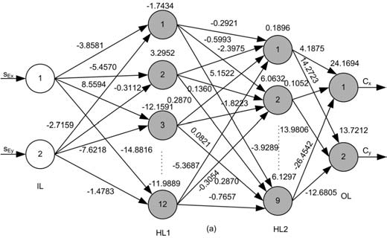
The Math of
Machine Learning and Neural Networks
A look at machine learning from a Calculus III perspective

Slide 2
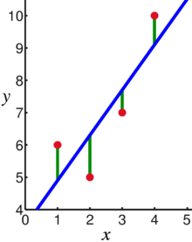
The Foundation
Machine learning as a field operates under the assumption that a program can be trained to minimize the error, or “cost function,” of its prediction algorithm.

Slide 3
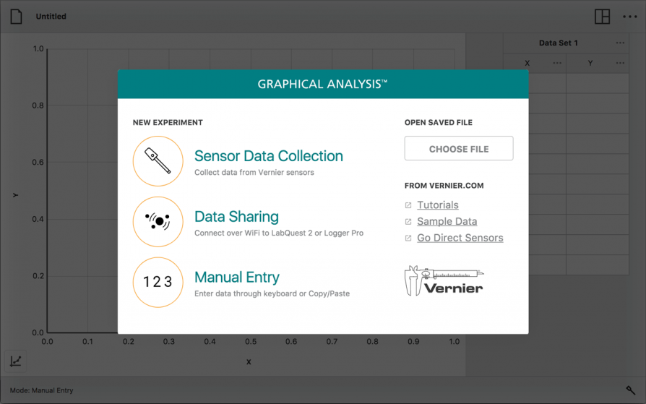
Daily Application
The simplest example of this we see in our own lives is any sort of regression we do on data we collect in labs.

Slide 4
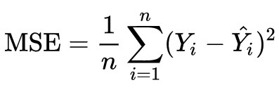
The Math of a Proportional Regression
In a proportional regression, data is fitted such that values can be predicted by multiplying an input by some coefficient.
This process involves iteratively looking at the mean squared error between all the data points and our current prediction model.
Your initial coefficient, A, could be a random number and will improve over time.
n is the number of data points
Y is the actual output for a given data point
Ŷ is the predicted output for that data point. In this case, it would be A * x_{i}

Slide 5
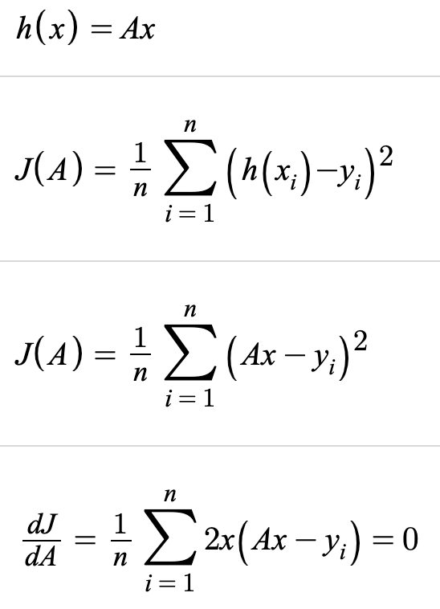
Solving for the Coefficient
Our prediction, or hypothesis, is h(x) = Ax
We can represent our mean squared error in terms of our coefficient as J(A).
This is a classic optimization problem. We want to minimize our cost function J, so we find what A makes it such that the derivative of J with respect to is zero.

Slide 6
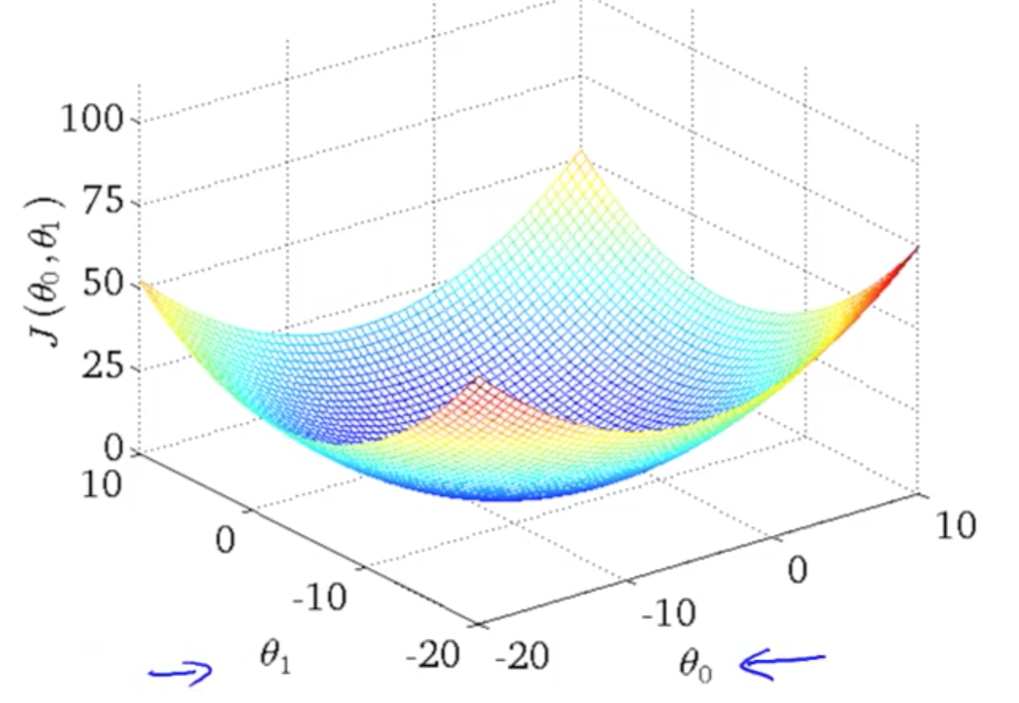
The Math of a Linear Regression
While a proportional regression only requires tuning one coefficient, a linear regression involves both a slope and a y-intercept.
In machine learning, these terms are known as a weight and a bias.
The graph of a cost function becomes three dimensional, with an axis for the value of the weight, the value of the bias, and their corresponding mean squared error.

Slide 7
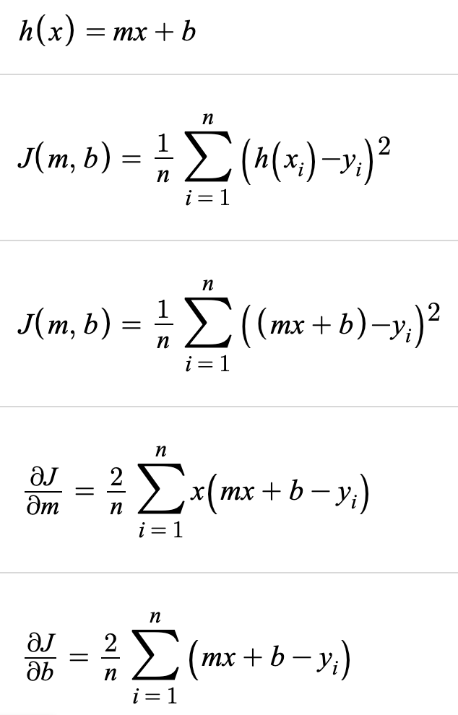
Solving a Linear Regression
Now we need to minimize our cost function using partial derivatives, where we get the change in error with respect to both the slope and y-intercept equal to 0
In the future, we will say weight and bias instead of slope and intercept.

Slide 8
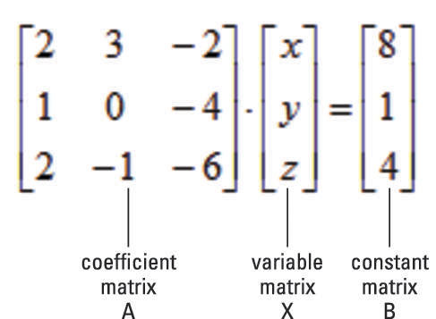
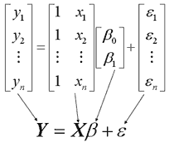
Solving a System of Equations with Matrices
Notes:
https://www.mathsisfun.com/algebra/systems-linear-equations-matrices.html
https://machinelearningmastery.com/solve-linear-regression-using-linear-algebra/

Slide 9
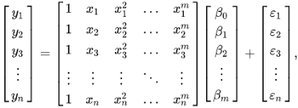
Solving a Polynomial Regression with Matrices
Same principle, but you can square (or cube or whatever you want) your inputs, and they’re treated as more inputs into a linear regression.

Slide 10
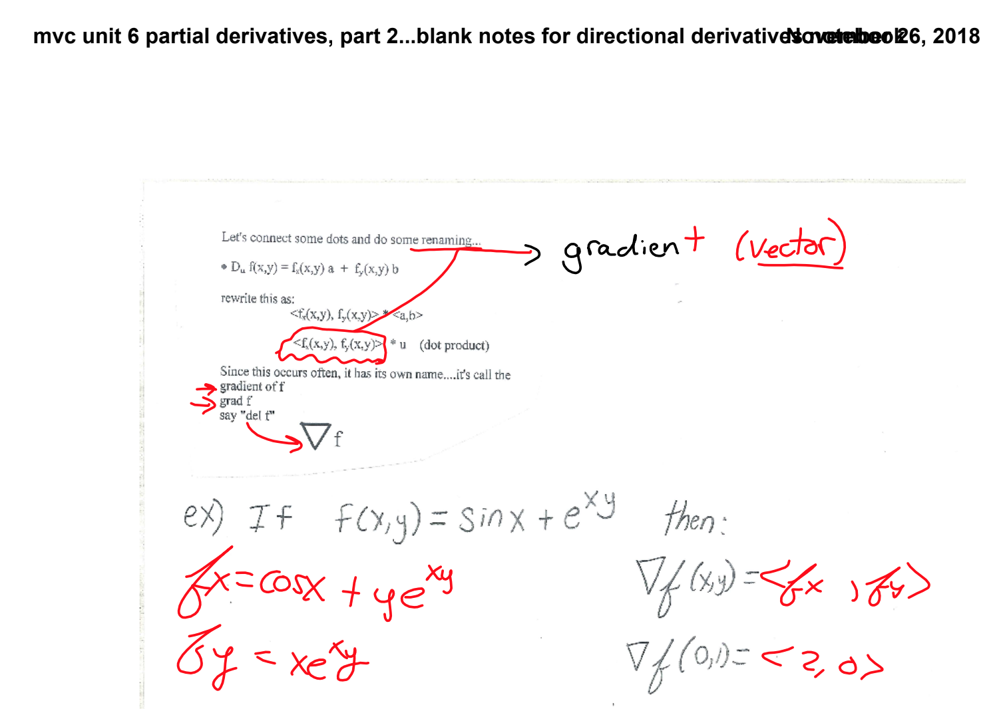
Fun Flashback to Unit 6

Slide 11
Gradient Descent
The next question becomes: What can you do with this error if you don’t know what your model is going to be? Your data may not always fit a linear model, so you can’t simply differentiate your cost function and find a minimum.
Furthermore, computers cannot inherently think of a function as a whole. They can only see what a function looks like where the computer has calculated its value at discrete inputs.
This is where calculus comes in, in the process of gradient descent, where you look at the derivative of your error with respect to your coefficient in order to adjust the coefficient correspondingly.

Slide 12
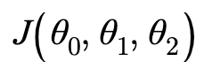
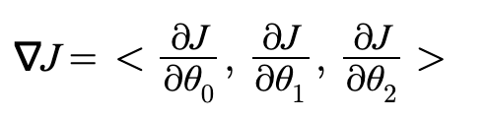
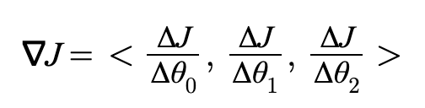
Review of Gradients
If we have a cost function for some sort of model that requires training three parameters, then the gradient vector can be found with the del operator.
Of course, because computers only deal with discrete inputs, the computer would look at incremental changes of the cost each time it changes a weight.

Slide 13
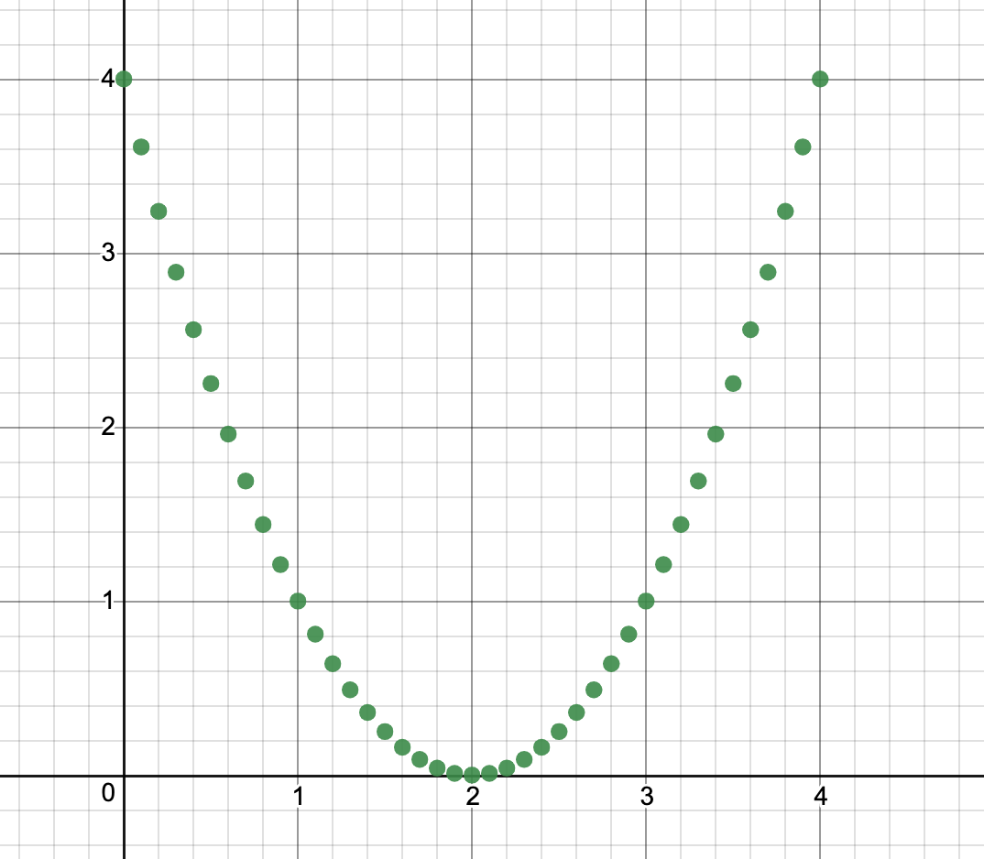
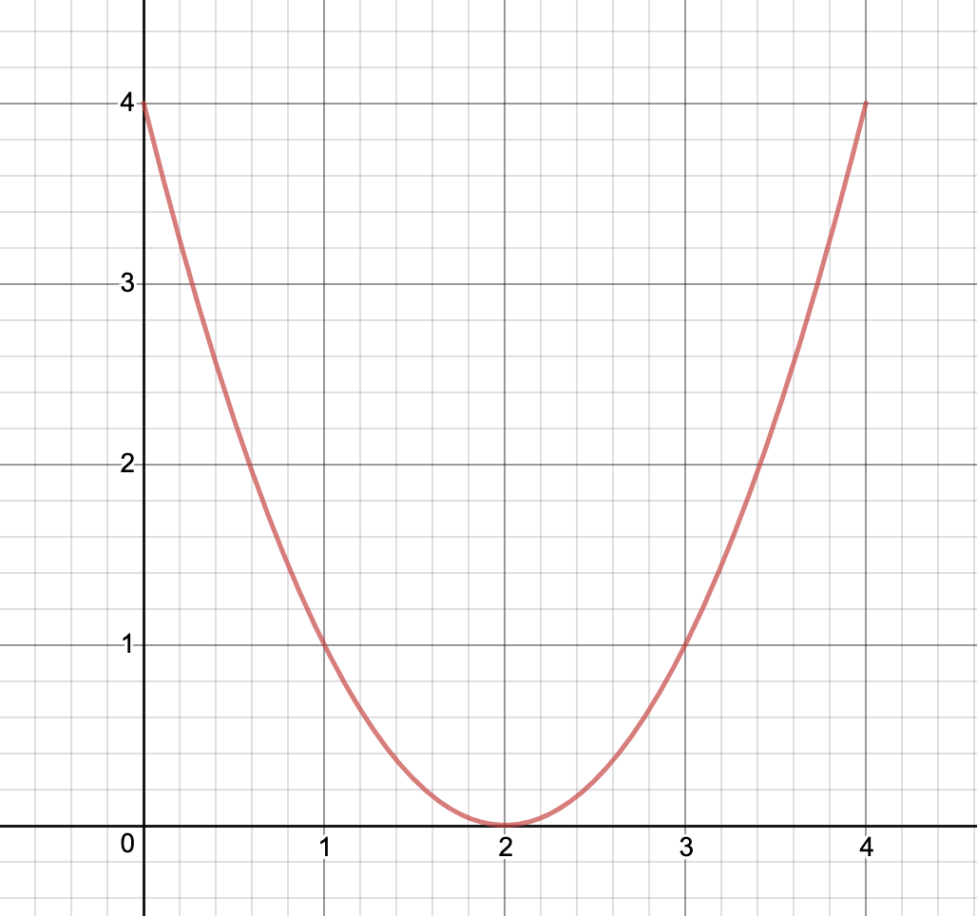
Functions: Discrete Values in a Computer
For the equation y = (x - 2)²
What the computer sees
What a human thinks

Slide 14
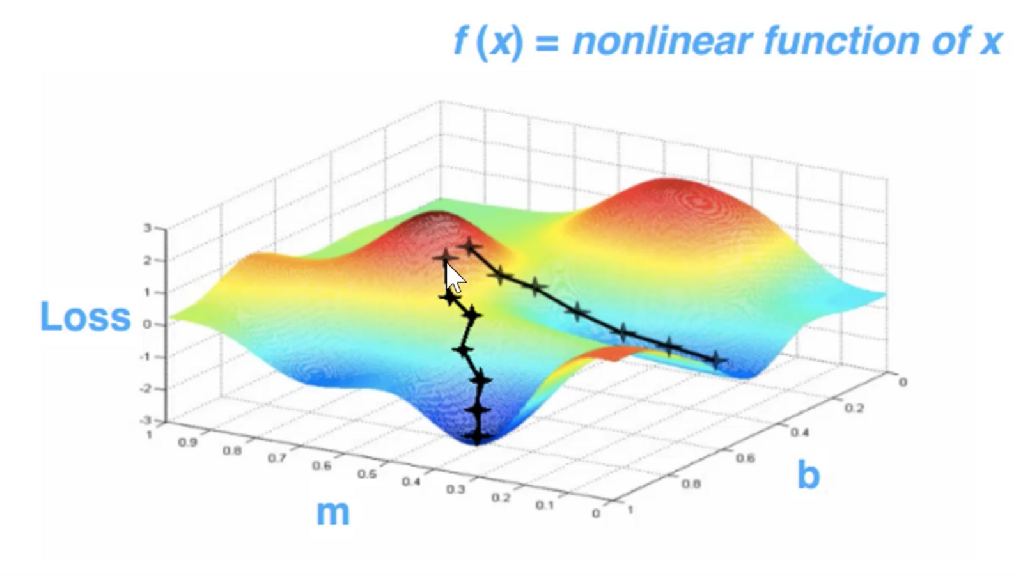
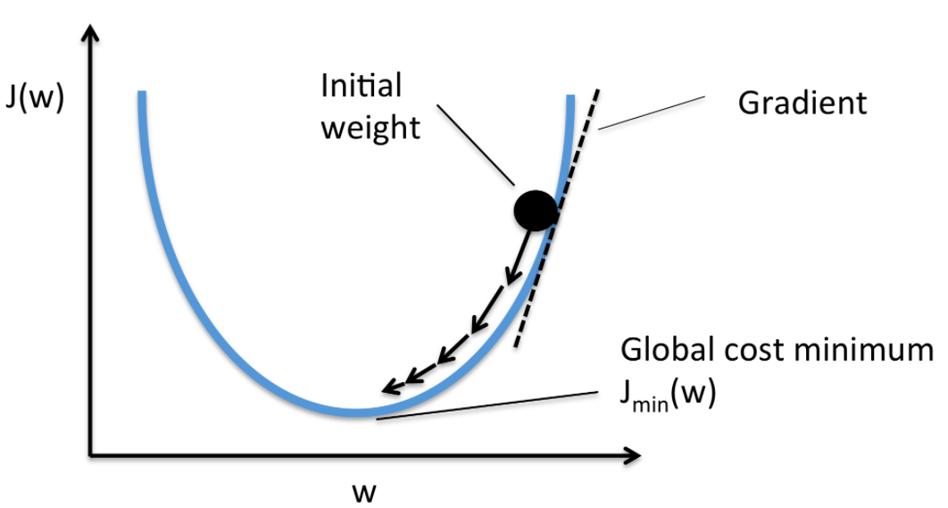
Gradient Descent
When your error is changing a lot, you will adjust your coefficient a lot in the direction that seems to be working.
When your error is changing slowly, you will adjust your coefficient more precisely.
Gradient descent is visualized as a ball rolling down the steepest path to the bottom.

Slide 15

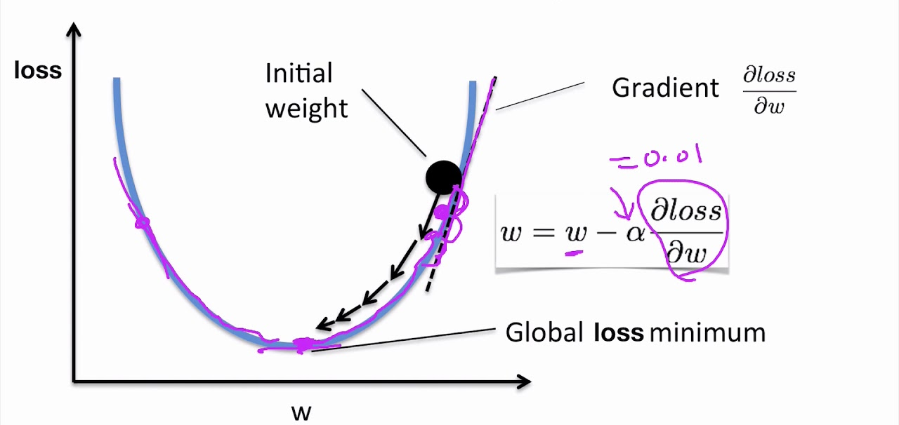
Learning Rates
In order to decrease our cost, we adjust each parameter (weight or bias) opposite its partial derivative and proportional to a learning rate α, or some constant that will make sure we don’t overshoot our goal and oscillate.

Slide 16
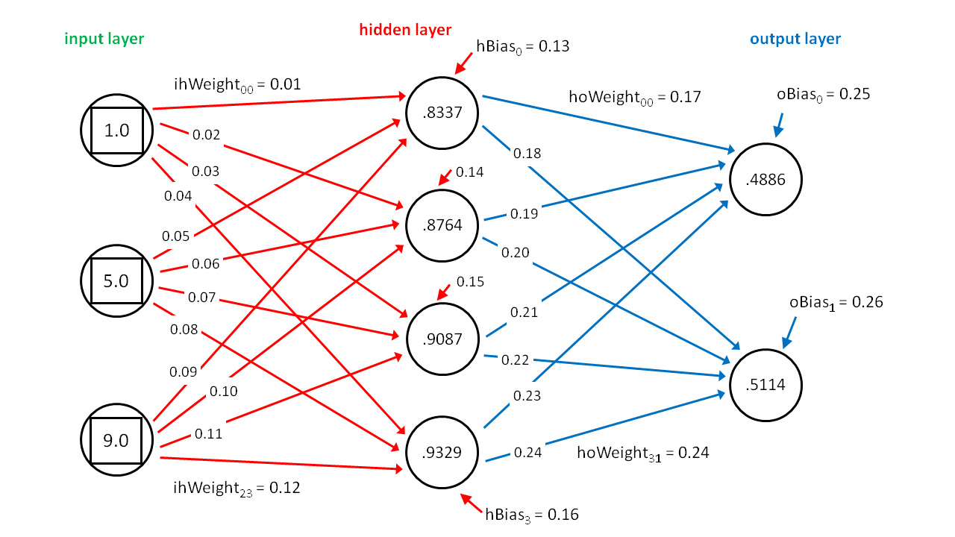
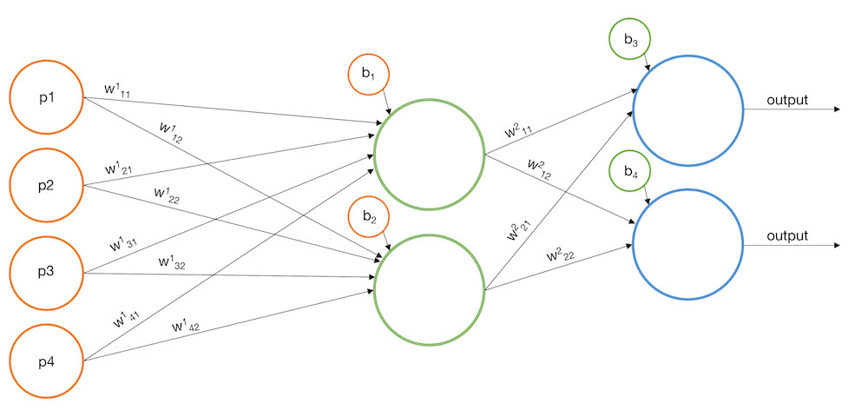
The Next Step: Neural Networks
A neural network is a type of model in which each connection between “nodes” has its own weight and each node has a bias.
Nodes are organized into layers.
In the simplest type of neural network, known as a multilayer perceptron, each node has a connection to each node in the next layer.

Slide 17
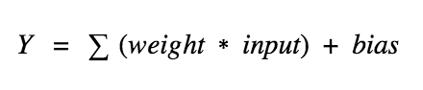

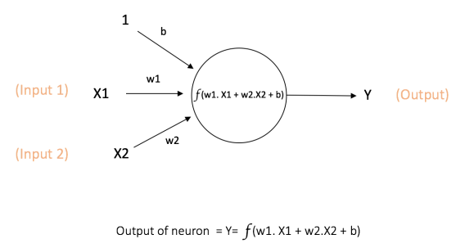
The Next Step: Neural Networks
It can be visualized as several regressions in one model.
The output of one node is the sum of all its inputs multiplied by their respective weights, plus a bias.
Each node is essentially one linear regression that must be tuned to give a good input to the next layer.

Slide 18
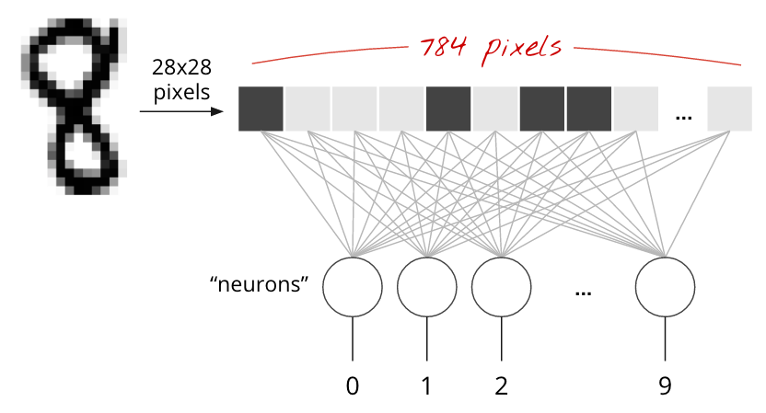
Another Advantage: Multiple Outputs

Slide 19
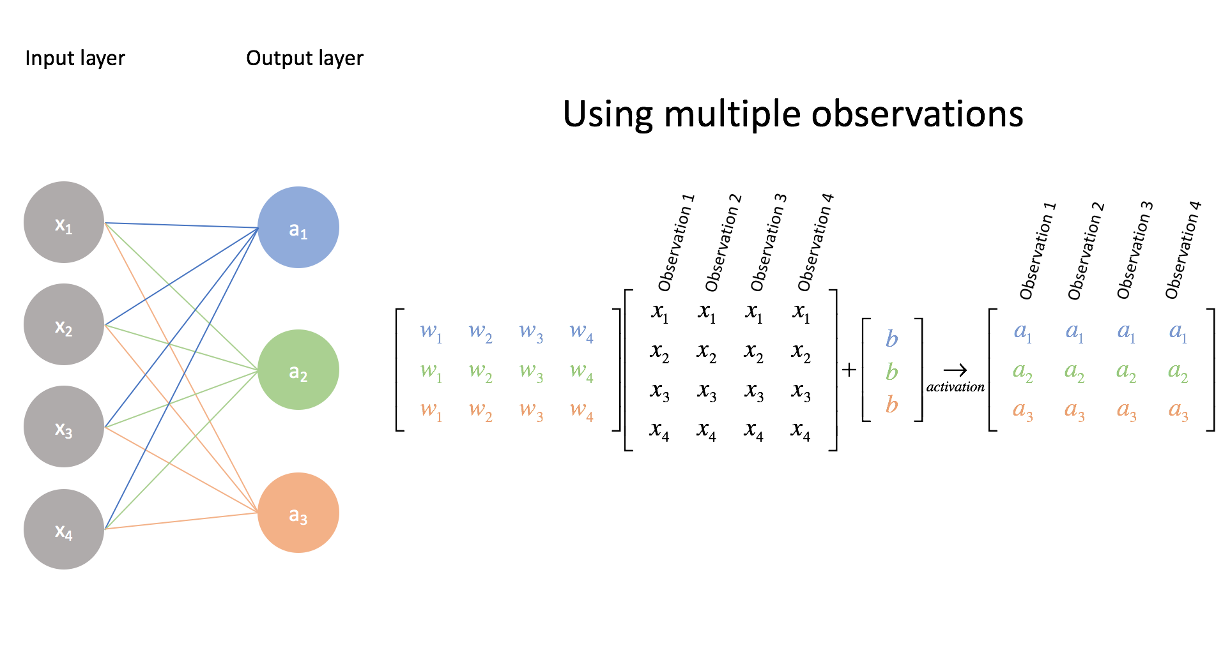
Evaluating with Matrices
Much of machine learning and especially neural networks is expressed with matrices.
If a layer L₁ has N neurons and the next layer L₂ has M neurons, then the weight matrix has the dimensions N by M (N rows, M columns).
The bias vector for L₁ would be an N by 1 matrix.
Weight matrix
(N x M)
Input
matrix
(# samples x N)
Bias vector
(M x 1)
N=4 M=3
Notes:
https://medium.com/coinmonks/the-mathematics-of-neural-network-60a112dd3e05

Slide 20
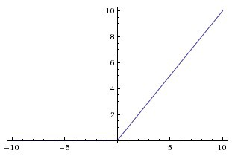
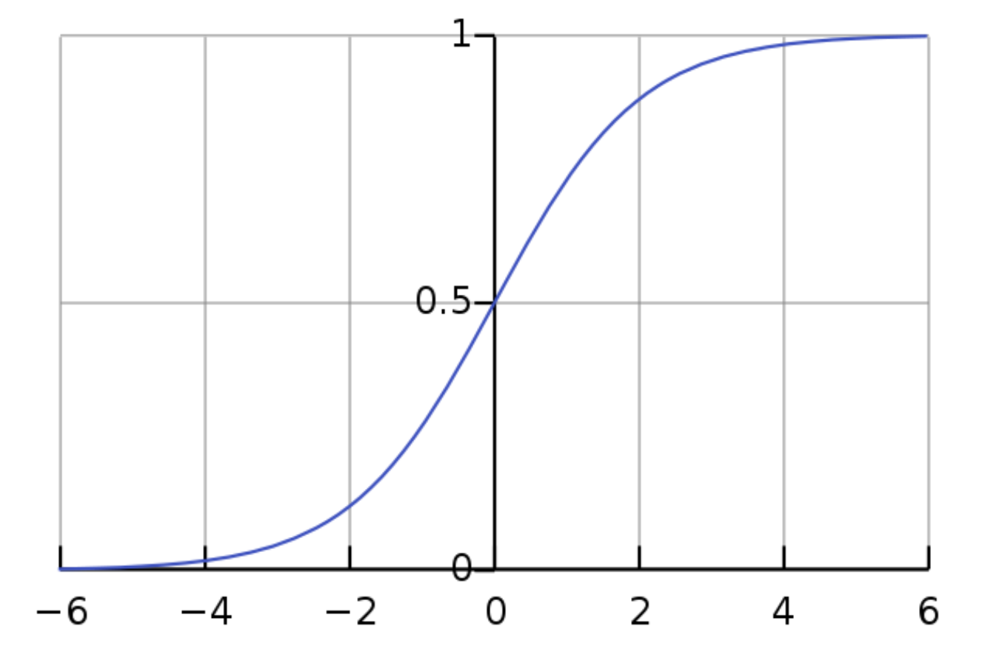
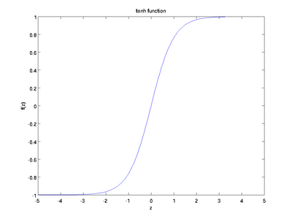
Activation Functions
In order to avoid creating just another linear function, each node’s output is put into an activation function before being passed to the next layer.
ReLU (rectified linear unit) is often used in hidden layers.
It is linear when the input is greater than 0, and otherwise is just 0.
Sigmoid and hyperbolic tangent are also popular, moreso in the output layer.
Notes:
https://medium.com/the-theory-of-everything/understanding-activation-functions-in-neural-networks-9491262884e0

Slide 21
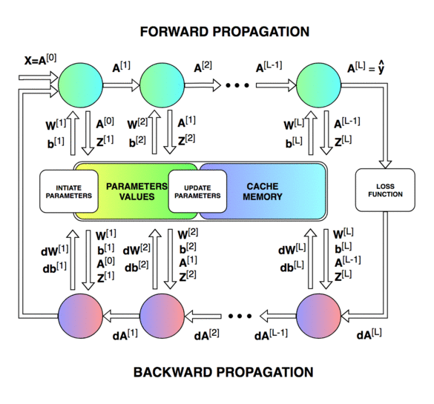
Back Propagation
In theory, this can be explained neatly. However, things get messy when the actual implementation begins.
In order to train our model by tuning the weights and biases of each neuron, we must use a process called back propagation, during which we employ gradient descent.
Notes:
https://towardsdatascience.com/lets-code-a-neural-network-in-plain-numpy-ae7e74410795
https://machinelearningmastery.com/implement-backpropagation-algorithm-scratch-python/

Slide 22
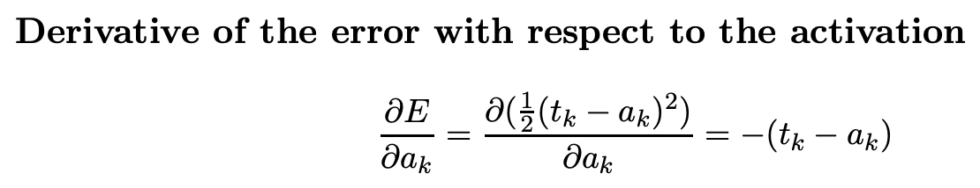
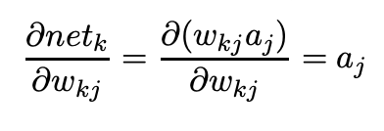
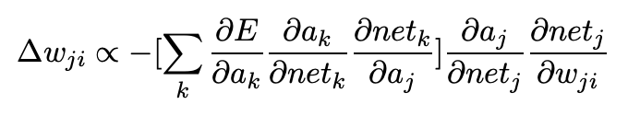
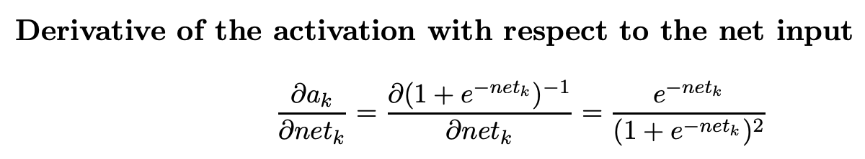
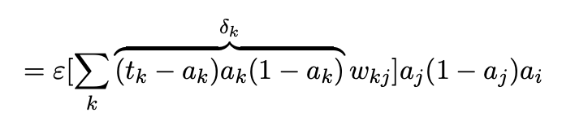
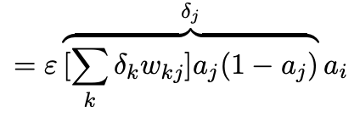
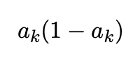
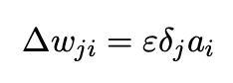
Complicated Derivation of Back Propagation
Derivative of error with respect to activation
Derivative of activation with respect to net input
Rewritten as
Derivative of net input with respect to weight
A bunch of substitution and then
Notes:
https://www.cs.swarthmore.edu/~meeden/cs81/f15/BackPropDeriv.pdf

Slide 23
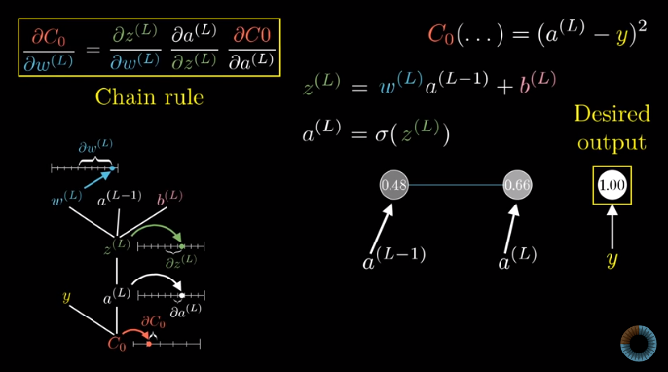
Blah blah, it’s just the chain rule!
Notes:
Notation: https://www.youtube.com/watch?v=tIeHLnjs5U8
Conceptual: https://www.youtube.com/watch?v=Ilg3gGewQ5U
Sample: https://github.com/mnielsen/neural-networks-and-deep-learning/blob/master/src/network.py

Slide 24

Convolutional Neural Networks
This description can be most basically applied to multilayer perceptrons. Another common type of neural networks is the convolutional neural net, which essentially adds another dimension to the matrices, taking in an input matrix rather than an input vector.

Slide 25
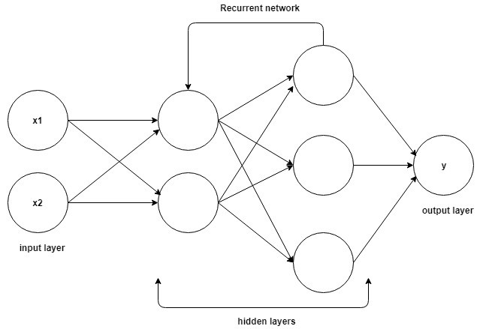
Recurrent Neural Networks
Recurrent neural networks take in a series of inputs sequentially, where the weights and biases add up. This is useful for text generation and parsing, and data analysis over time, such as securities values.

Slide 26
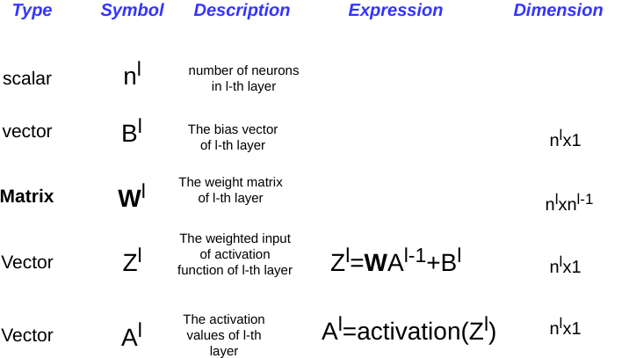
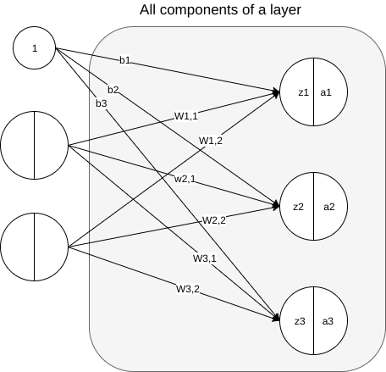
Demonstration
In order to understand this code, it is important to remember these shorthands.
Notes:
https://medium.com/@a.mirzaei69/implement-a-neural-network-from-scratch-with-python-numpy-backpropagation-e82b70caa9bb

